Slide 1
Python Data Types
DVT101 – Lecture 7
- By Dataverse Tutorials

Slide 2
Introduction
What are Data Types?
Why data types matter
Python as object-oriented language

Slide 3
Why Data Types Are Important
Memory management
Allowed operations
Error prevention
Performance optimization

Slide 4
Built-in Data Types Overview
Numeric
Sequence
Mapping
Boolean
Set
Binary

Slide 5
Dynamic Typing in Python
No type declaration
Variable re-assignment
Runtime type change

Slide 6
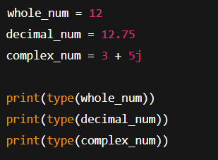
Numeric Data Types – Overview
int
float
complex

Slide 7
Sequence Data Types – Introduction
Ordered collection
Index-based access
Multiple values storage

Slide 8
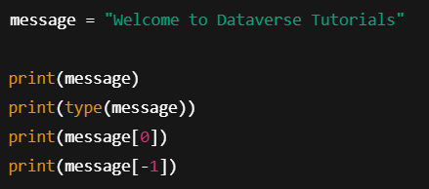
String Data Type
Text data
Unicode characters
Indexing supported

Slide 9
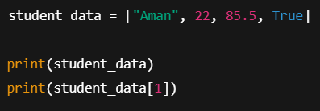
List Data Type
Mutable
Ordered
Mixed data allowed

Slide 10
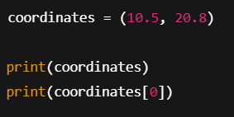
Tuple Data Type
Immutable
Ordered
Faster than list

Slide 11

Boolean Data Type
True / False
Condition evaluation
Logical flow control

Slide 12

Set Data Type
Unordered
Unique elements
No indexing

Slide 13
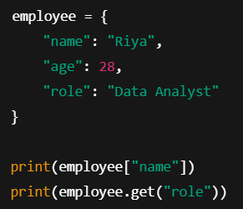
Dictionary Data Type
Key-value pairs
Fast lookup
Mutable

Slide 14
Real-World & Industry Usage
Data Science pipelines
ML feature storage
API handling
Configuration management

Slide 15
Summary & Key Takeaways
Everything is an object
Choose correct data type
Foundation for Python mastery

Slide 16


